Slide 1

Chapter 8
Disruptive Environments and Digital Business Strategies: Leveraging Internet and eBusiness Capabilities

Slide 2
Learning Objectives
After reading this chapter, you should have a good understanding of:
  How the Internet is disrupting industry structures and how Internet technologies are affecting the five competitive forces.
  Why use of Internet technologies is more important to achieving competitive advantage than the technologies themselves.
  How firms are using Internet technologies to add value and achieve unique advantages.
  How firms can improve their competitive position by effectively deploying e-business strategies.

Slide 3
How the Internet is Affecting the Five Competitive Forces: Threat of New Entrants
Internet technologies lower barriers to entry
Scale economies may be less important in Internet context
New entrants can go to market with lower capital costs
Businesses on the Internet may have lower expenses such as office rent, printing, and postage

Slide 4
How the Internet is Affecting the Five Competitive Forces :
Bargaining Power of Buyers
End users
  Final customers in a distribution channel
  B2C Internet sales activity (business to consumer)
  Internet increases the power of these buyers
    more information
    Lower switching costs
  Such buyers likely to have more bargaining power
Buyer channel intermediaries
  Wholesalers, distributors, and retailers
  Internet makes it easier for the business to reach consumers directly
  Internet may decrease the bargaining power of buyer channel intermediaries

Slide 5
How the Internet is Affecting the Five Competitive Forces :
Bargaining Power of Suppliers
B2B—providing products or services to other businesses
Advantages
  Access to business customers at lower cost
  More downstream outlets
  Creation of Web-based purchasing arrangements
    Makes purchasing easier
    Discourages customers from switching
  Can reach end users without intermediaries

Slide 6
How the Internet is Affecting the Five Competitive Forces:
Bargaining Power of Suppliers
Disadvantages
  Buyers can shop competitively and negotiate prices easier
  Inhibited ability to offer differentiated products or unique services
Creating new functions (re-intermediation)

Slide 7
How the Internet is Affecting the Five Competitive Forces: Threat of Substitutes
Threat of substitutes is increased because the Internet creates new ways to accomplish the same tasks
  Alternative way to participate in conferences
  Storing information on the Web
  Online market surveys
Primary factor increasing substitution is economic

Slide 8
How the Internet is Affecting the Five Competitive Forces: Intensity of Rivalry
Rivalry is likely to be more intense
  More tools and means for competing
  New firm technologies can be imitated easily and quickly
  Competitors in cyberspace are more equally balanced and competitive
  Infomediaries increase importance of pricing

Slide 9
How the Internet Influences
Industry Structure
Threat of new substitutes
  (+) by making an overall industry more efficient, the internet can expand sales in that industry
  (-) internet-based capabilities create new substitution threats
  (-) technology-based efficiencies can be captured, lowering the impact of scale economies
  (-) differences among competitors are difficult to detect and to keep proprietary
Adapted from Exhibit 8.3 How the Internet Influences Industry Structure
Source: Adapted from M. E. Porter, “Strategy and the Internet,” Harvard Business Review, March 2001, pp. 63-78.

Slide 10
How the Internet Influences
Industry Structure
Bargaining power of buyers
Bargaining power of channels
  (+) eliminates powerful channels or improves bargaining power over traditional channels
Bargaining power of end users
  (-) shifts bargaining power to consumers
  (-) reduces switching costs
Adapted from Exhibit 8.3 How the Internet Influences Industry Structure
Source: Adapted from M. E. Porter, “Strategy and the Internet,” Harvard Business Review, March 2001, pp. 63-78.

Slide 11
How the Internet Influences
Industry Structure
Bargaining power of suppliers
  (+-) procurement using the Internet may raise bargaining power over suppliers, but it can also give suppliers access to more customers
  (-) the Internet provides a channel for suppliers to reach end users, reducing the power of intermediaries
  (-) Internet procurement and digital markets tend to reduce differentiating features
  (-) reduced barriers to entry and the proliferation of competitors downstream shifts power to suppliers
Adapted from Exhibit 8.3 How the Internet Influences Industry Structure
Source: Adapted from M. E. Porter, “Strategy and the Internet,” Harvard Business Review, March 2001, pp. 63-78.

Slide 12
How the Internet Influences
Industry Structure
Threat of new entrants
  (-) reduces barriers to entry such as need for a sales force, access to channels, and physical assets
  (-) Internet applications are difficult to keep proprietary from new entrants
  (-) a flood of new entrants has come into may industries
Adapted from Exhibit 8.3 How the Internet Influences Industry Structure
Source: Adapted from M. E. Porter, “Strategy and the Internet,” Harvard Business Review, March 2001, pp. 63-78.

Slide 13
How the Internet Influences
Industry Structure
Rivalry among existing competitors
  (-) more priced-based competition intensifies rivalry
  (-) widens the geographic market, increasing the number of competitors
Adapted from Exhibit 8.3 How the Internet Influences Industry Structure
Source: Adapted from M. E. Porter, “Strategy and the Internet,” Harvard Business Review, March 2001, pp. 63-78.

Slide 14

How the Internet Adds Value
The process of gathering information and identifying purchase options
  Faster speed of information gathering (buyers, suppliers)
  Greater breadth of information that can be accessed (buyers)
  Decreased cost of search (buyers)
  Easier to be found (suppliers)

Slide 15

How the Internet Adds Value
The process of considering alternatives and comparing the costs and benefits of various options
  Facilitates comparative shopping (buyers)
  Provides product reviews (buyers)
  Catalogues customer evaluations of performance (buyers, suppliers)

Slide 16

How the Internet Adds Value
The process of identifying problems or needs and generating ideas and action plans to address those needs
  Ability to handle unique problems individually (buyers, suppliers)
  Ability to provide immediate answers (buyers, suppliers
  Ability to deliver new products and services (suppliers)

Slide 17

How the Internet Adds Value
The process of completing the sale, including negotiating and agreeing contractually, making payments, and taking delivery
  Lowering overall transaction cost (buyers, suppliers)
  Permitting more rapid sales (buyers, suppliers)
  More reliable transactions

Slide 18
How the Internet Adds Value
Internet content as a source of competitive advantage
  Customer feedback
    Buyers trust what other buyers say more than a company’s promises
    Customer testimonials
  Expertise
    Internet as a library
    Education of consumers regarding options and implications of various choices
  Entertainment programming
    Streaming media
    Interactive programming and other applications

Slide 19
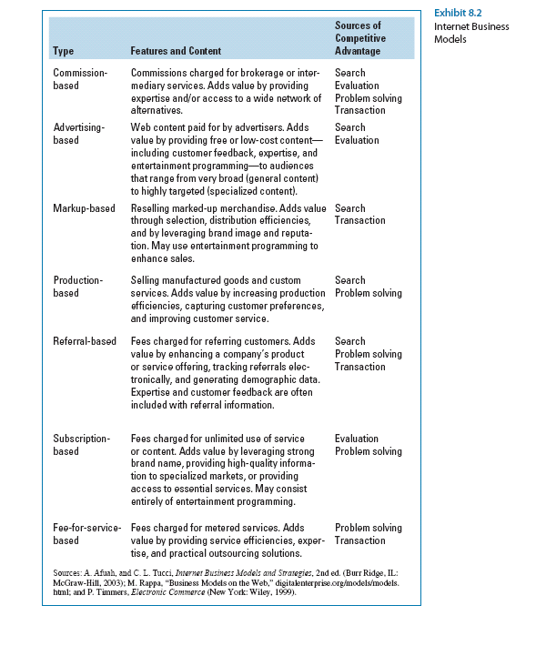
Internet Business Models

Slide 20
Overall Cost Leadership Strategy and the Internet
Internet can decrease costs throughout a firm’s value chain in both primary and support activities
  Minimizing rework
    Direct access to progress reports
    Ability for customers to periodically check work in progress
  Minimizing sales-force expenses
    Online bidding
    Online order processing
  Reducing costs of procurement and paper
    Online purchase orders makes many transactions paperless

Slide 21
Overall Cost Leadership Strategy and the Internet
Internet can decrease costs throughout a firm’s value chain in both primary and support activities
  Reducing costs and speeding the process of new-product development
    Collaborative design efforts (internet links designers, materials suppliers, and manufacturers)
  Reducing costs of hiring and training employees
    Online testing
    Online evaluation
    Online training

Slide 22
Differentiation Strategy and the Internet
Internet can create new ways of differentiating by enabling mass customization and increasing customer control over the process
  Shortening response times and accelerating organization learning
    Internet-based knowledge management systems
    Linking all parts of the organization
  Personalizing online access so customers can access
    Prior orders
    Current order status
    Process requests for future orders

Slide 23
Differentiation Strategy and the Internet
Internet can create new ways of differentiating by enabling mass customization and increasing customer control over the process
  Enhancing marketing efforts
    Quick online response to service requests
    Rapid feedback to customer surveys and product promotions
  Empowered sales force and updated R&D efforts
    Online access to real-time sales and service information
  Access to detailed status reports and purchasing histories
    Automated procurement and payment systems

Slide 24
Focus Strategy and the Internet
Internet permits focusers to access markets less expensively (low cost) and provides more services and features (differentiation)
  Focusing sales efforts on specific customers
    Permission marketing techniques
  Creating community for customers with common interests
    Chat rooms
    Discussion boards
    Member functions

Slide 25
Focus Strategy and the Internet
  Internet permits focusers to access markets less expensively (low cost) and provides more services and features (differentiation)
  Providing advertisers with access to viewers with specialized interests
    Niche portals
  Minimizing firm infrastructure requirements
    Virtual organizing
  Online “officing”
  Highlighting specialized buyers and drawing attention to smaller suppliers
    Procurement technologies (matching buyers and sellers)

Slide 26
Potential Internet-Related Pitfalls
Low-cost leaders
  Ease of imitation by competitors
  Ease of comparison shopping by consumers
  Temptation to place too much emphasis on one business activity and ignore others
Differentiators
  Sustainability of internet gains may deteriorate if differentiating features are unwanted by customers
  Overpriced products and services
Focus
  Misreading scope and interests of target markets
  Efforts to read a broader audience can cause it to lose cost advantage

